Slide 1

DEEP DROWSINESS DETECTION
Presenting to:
Prof. Vejey Gandyer and Prof. Moe Fadaee
GROUP 12
Kumud. (101493945)
Himani. (101445554)
Erinda Kapllani (101495644)
Bhumika Pravinkumar Shukla: (101389078)

Slide 2
TABLE OF CONTENTS
BUSINESS CASE
Introduction
Problem Statement
Why this Problem
Requirement Gathering
Identifying stakeholders
Business Models
Competitive Analysis
Benefits and Risks
SWOT Analysis
FULL STACK
Literature Review
ML Canvas
Deep learning Model
Flask
Docker
Challenges
Demo
Conclusion
Q/A

Slide 3

INTRODUCTION
Issue: Deep drowsiness poses a significant threat to road safety.​
Factors contributing to drowsiness:
Fatigue
Alcohol consumption
Monotonous road conditions
Driving during inappropriate times
Consequences:
Increased accidents and fatalities
Impaired reaction time
Solution: ​
Introducing the Deep Drowsiness Detection System for Drivers​
Technology used: ​
Artificial Intelligence (AI)​
Machine Learning (ML)​
Functionality: ​
Identifying signs of drowsiness in drivers​
Alerting drivers to potential fatigue-related risks​

Slide 4

PROBLEM STATEMENT
Impact of Driver Drowsiness:
Contributes to a high number of accidents
Poses a significant risk to road safety
Affects not only the driver but also passengers and their families
Consequences:
Accidents, injuries, and loss of life
Emotional and financial distress for affected individuals and families
Statistics:
In the United States:
Over 72,000 crashes annually
Approximately 800 fatalities per year
Proposed Solution:​
Development and implementation of a Deep Drowsiness Detection System for Drivers​
Functionality:​
Utilizes AI and ML technologies​
Detects early signs of fatigue (e.g., eye movements, yawning, steering patterns)​
Alerts drivers with high sound alarms to prevent accidents and ensure road safety.​
​

Slide 5
WHY THIS PROBLEM
Significant Impact: Driver drowsiness contributes to a high number of accidents risking the lives of not only the driver but also to the co-passengers due to the driver's carelessness.
Market Demand: There's a growing need for solutions that improve road safety by detecting driver drowsiness. Our business model meets this demand.
Safety Innovation: Developing a Deep Drowsiness Detection System showcases our commitment to innovative safety technology, setting us apart in the market.
Competitive Edge: Offering an advanced drowsiness detection solution gives us a competitive advantage, appealing to safety-conscious customers.
Scalability: We can expand our business by providing this technology to car manufacturers, fleet managers, and transportation services.

Slide 6
REQUIREMENT GATHERING
Researched numerous articles detailing daily accident statistics.
Determined the primary sources of these articles.
Conducted brainstorming sessions to devise strategies for addressing the identified challenge.
Examined safety features offered by various car manufacturers to assess the presence of similar solutions.
Formulated the project solution based on our findings and discussions.
Engaged in brainstorming sessions to determine additional features to incorporate into the project solution.

Slide 7
IDENTIFYING STAKEHOLDERS
Stakeholders for the Deep Drowsiness Detection System are those who deeply care about its development, usage, and outcomes, as their influence significantly affects its success and adoption. Here's who they are:
Drivers
Developers and Engineers
Automobile Manufacturers (Car Companies)
Fleet Managers and Operators
Insurance Companies
Government Agencies (Regulatory Authorities)
Investors and Financial Backers
Passengers (End Users)

Slide 8
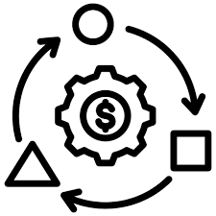
BUSINESS MODELS
1)Strategic Perspective: Our goal is to develop a leading drowsiness detection system, fostering partnerships with industry stakeholders. We'll tailor our approach to meet specific driver needs, ensuring market success.
2)Economic Perspective: We'll highlight our system's cost-saving potential by preventing accidents and reducing associated costs. Thorough analysis will demonstrate its practical value and feasibility in the market.
3)Commercial Perspective: Our strategy involves customizing marketing to reach target customer groups effectively. Collaborating with manufacturers and insurers maximizes our system's impact and market success.

Slide 9
BUSINESS MODELS
4) Financial Perspective: We'll assess costs, revenue potential, and risks to ensure long-term stability and success, enabling effective resource planning.
5) Management Perspective: Clear goals, collaboration, and stakeholder engagement drive efficient development and successful outcomes.

Slide 10
Competitive analysis
Autopilot Features (e.g., Tesla Autopilot):
Pros:
Offers semi-autonomous driving capabilities, enhancing driver convenience and comfort.
Showcases advanced technology and innovation in the automotive industry.
Cons:
Requires continuous driver monitoring to ensure safe operation.
Potential over-reliance on automation, leading to decreased driver alertness.
Vigilant Driver Safety System (Our System):
Pros:
Specifically targets the critical issue of driver drowsiness, significantly improving road safety.
Utilizes AI and ML for accurate and timely detection of fatigue-related signs.
Complements existing vehicle safety features without compromising driver control.
Cons:
Requires integration into vehicle systems and collaboration with manufacturers for widespread adoption.
Addresses privacy concerns related to data collection and analysis for drowsiness detection.
Initial investment costs for research, development, and implementation may require substantial funding.

Slide 11
Benefits and Risks
Benefits:
Enhanced Road Safety
Accident Prevention
Reduced Insurance Costs
Improved Driver Well-being
Compliance with Safety Regulations
Market Differentiation
Risks:
Technical Limitations
Privacy Concerns
User Acceptance and Adaptation
Integration Complexity
Cost of Implementation
Regulatory Compliance

Slide 12

SWOT ANALYSIS
Strengths:
Enhanced Road Safety
Innovative Technology
Potential Cost Savings
Market Differentiation
Opportunities:
Growing Market Demand
Partnership Potential
Regulatory Support
Weaknesses:
Technical Limitations
Privacy Issues
User Acceptance
Initial Cost
Threats:
Competitive Landscape
Privacy Regulations
Technological Challenges
Economic Factors

Slide 13
LITERAURE REVIEW
Similar Projects:
An Efficient Approach for Detecting Driver Drowsiness Based on Deep Learning.
Drowsiness Detection Using ECG, PPG, and HRV Signals.
Drawbacks:
Relies heavily on the quality of real-time video data and may face challenges in different lighting conditions or with different face orientations.
The signals from wearable sensors can be noisy due to slight movements, reducing the accuracy and reliability of drowsiness detection .
Requires extensive training data to achieve high accuracy, and there's a challenge in ensuring consistent performance across diverse driving conditions and driver behaviors.

Slide 14
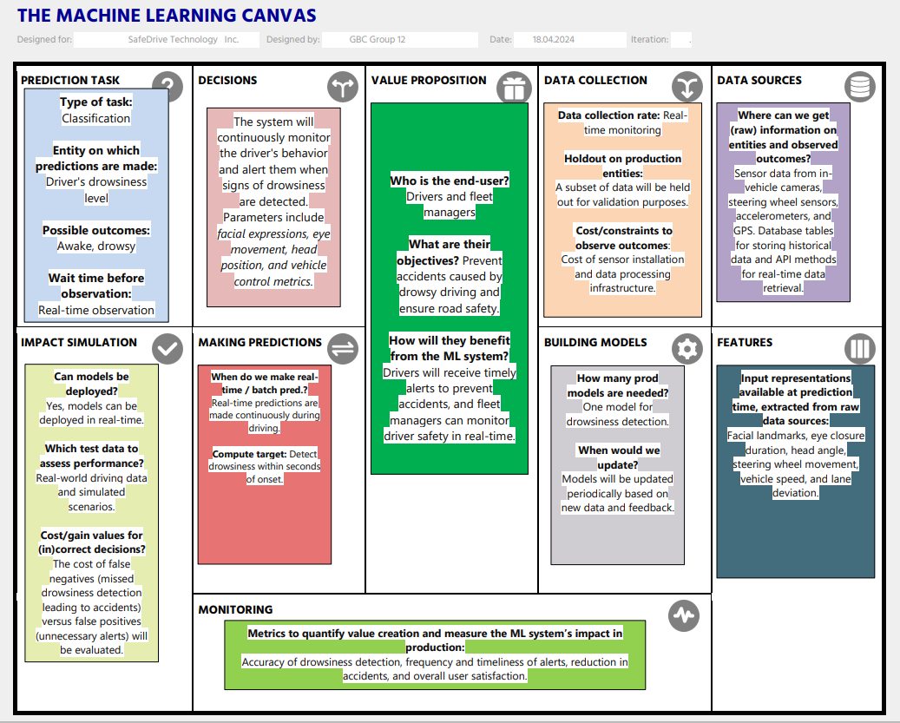
ML CANVAS

Slide 15
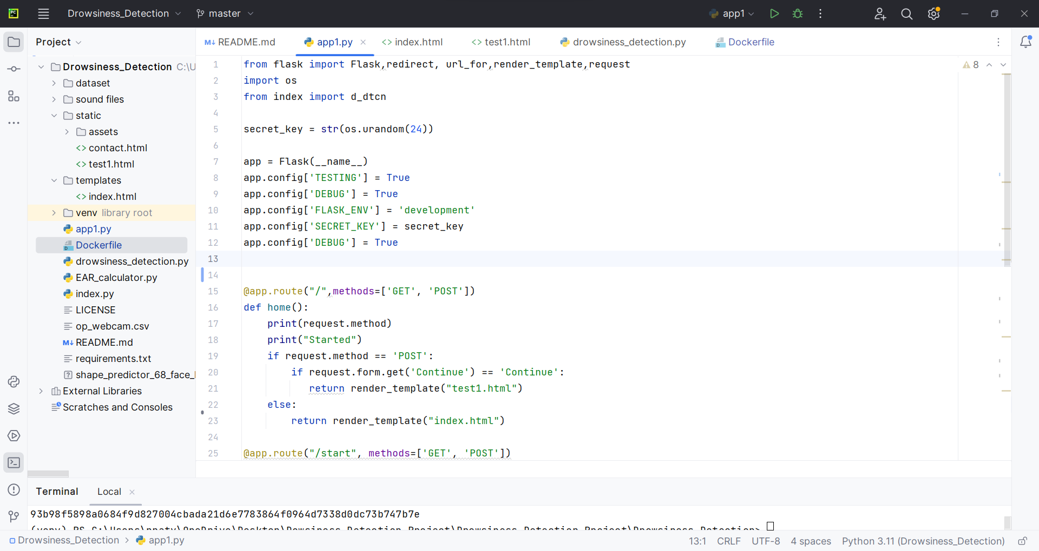
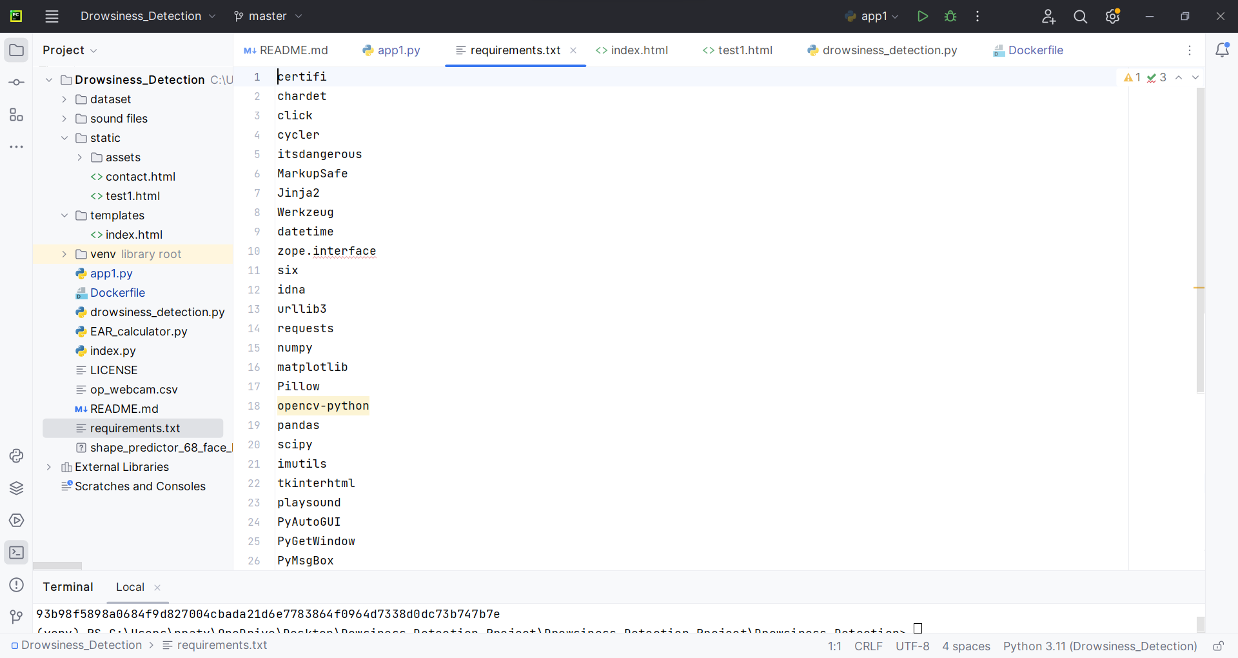
DEEP LEARNING MODEL
Python Script

Slide 16
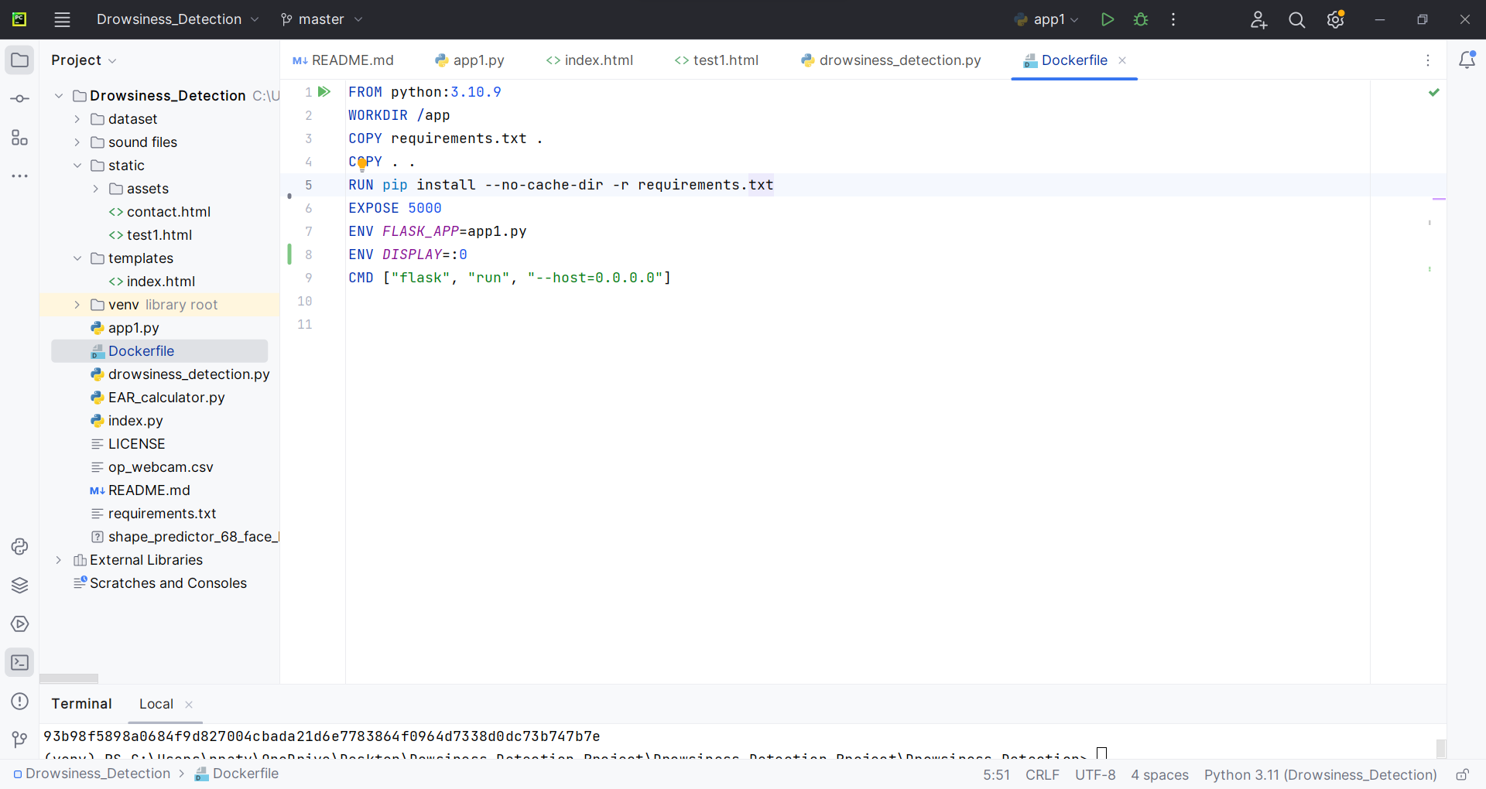
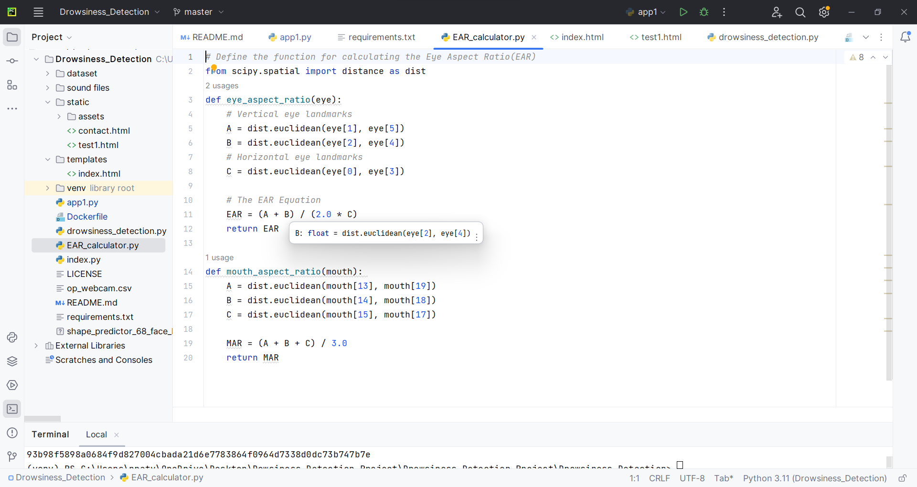
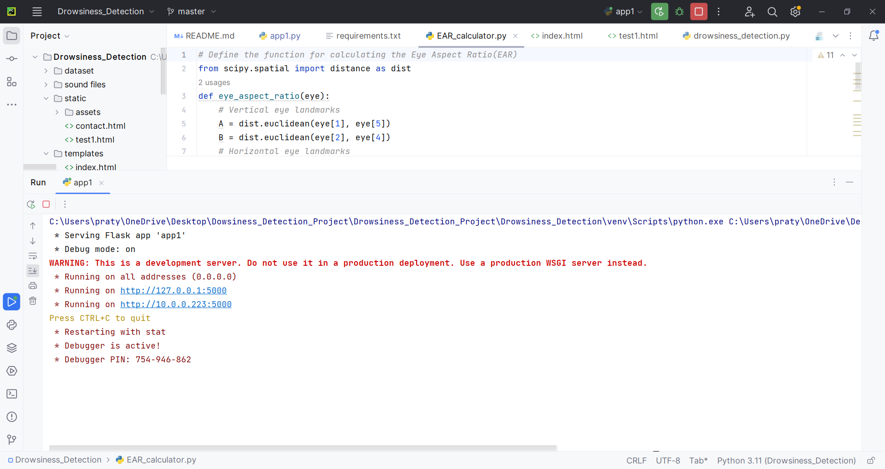
Python coDe Screenshot

Slide 17
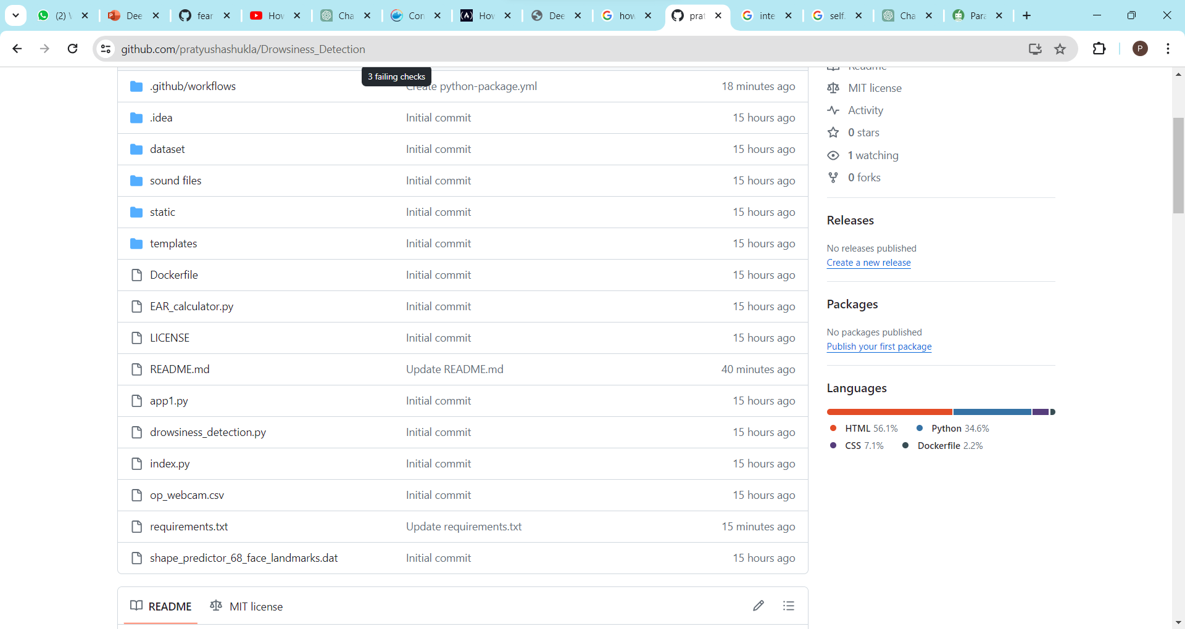
GIT Screenshot

Slide 18
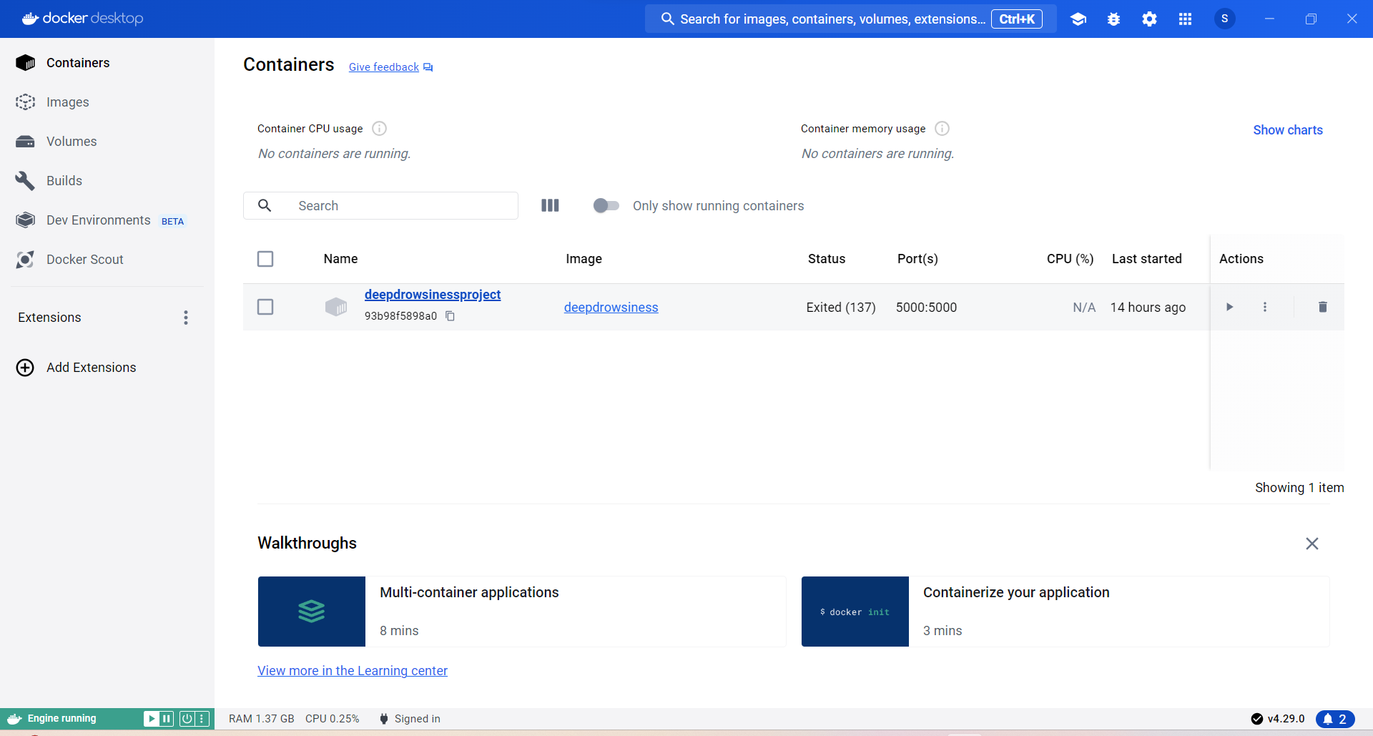
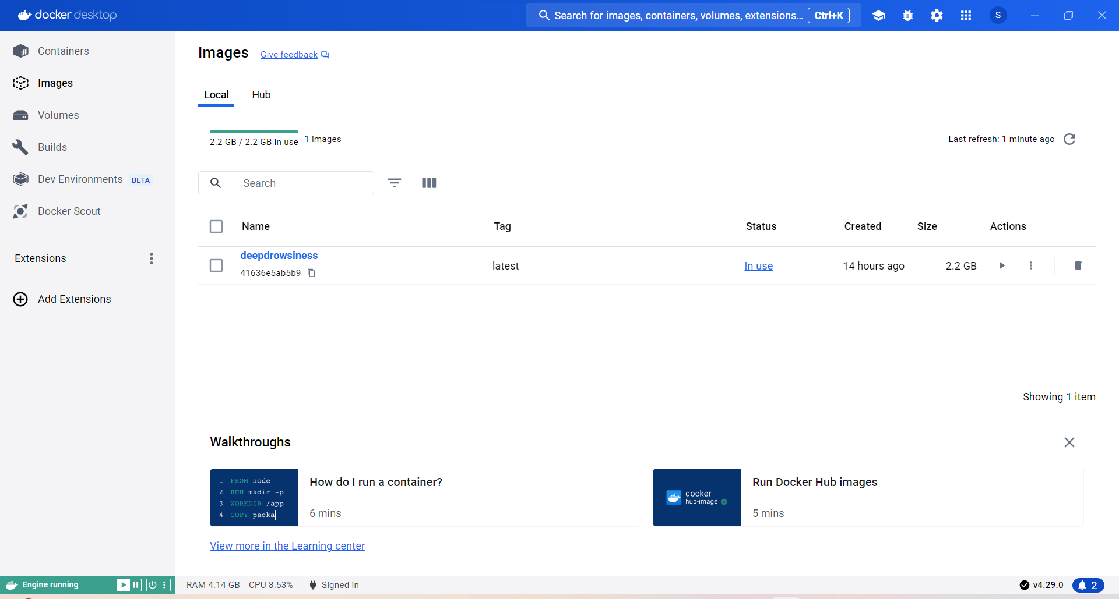
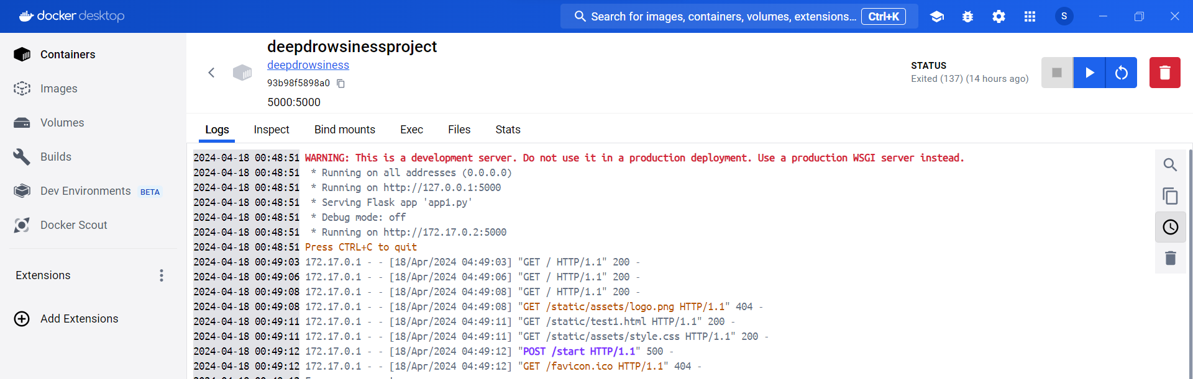
MODEL DEPLOYMENT: Docker

Slide 19
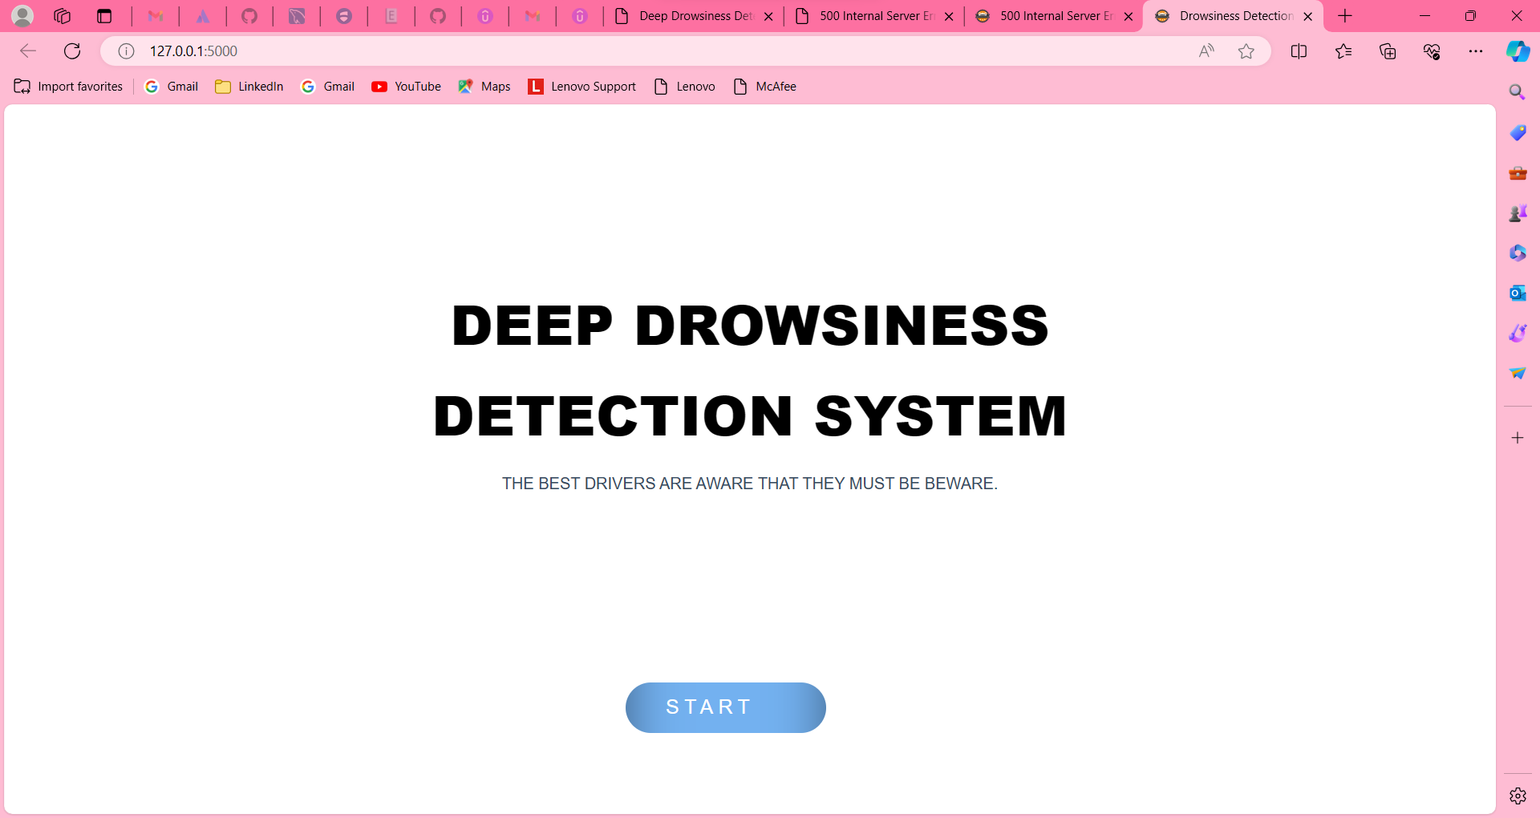
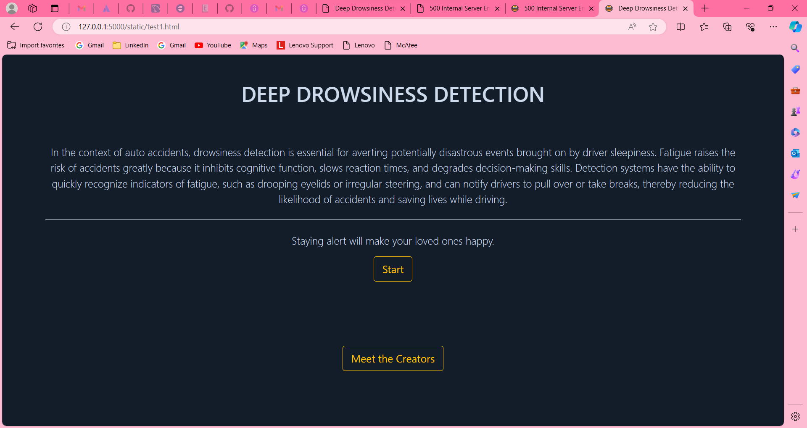
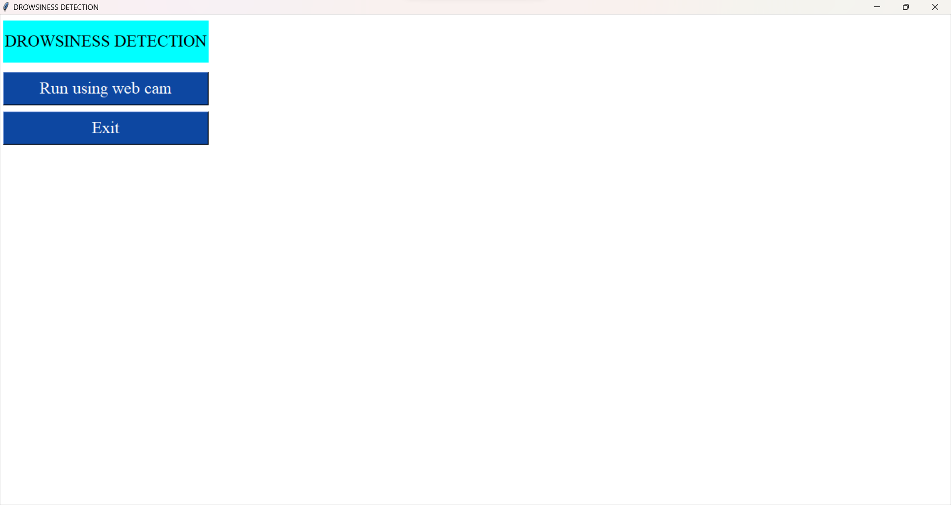


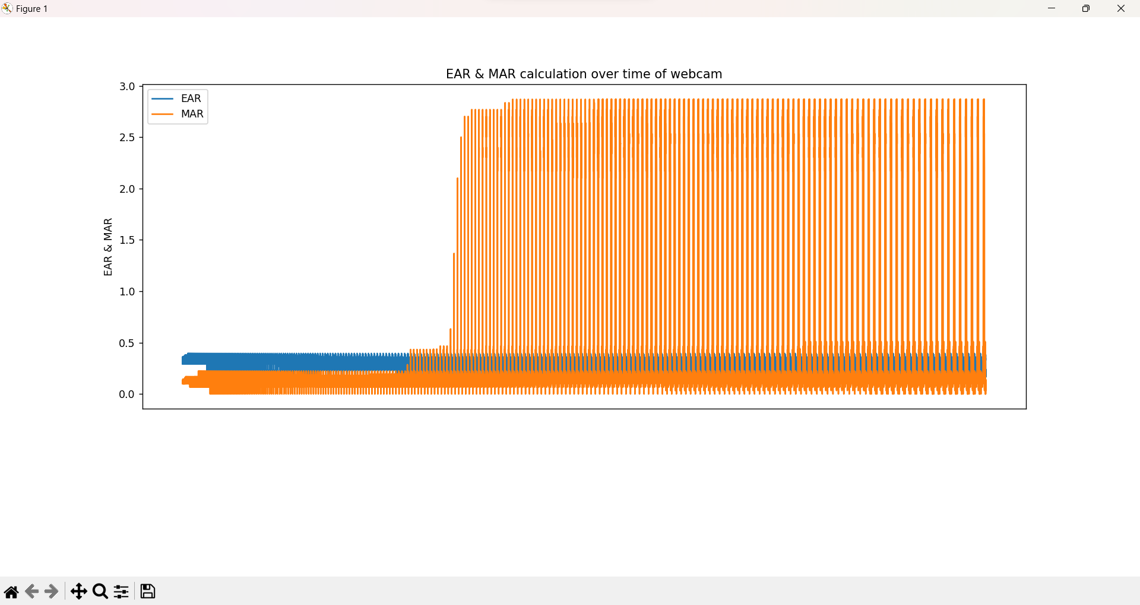
Application Screenshots

Slide 20
Challenges
Dependency Management: Dealing with dependency errors and conflicts during the development of Python scripts can lead to delays in debugging and troubleshooting, impacting overall development timelines and productivity.
Library Installation Delays: Lengthy installation times for specific libraries can significantly slow down the development process, affecting the ability to iterate quickly on code changes and experiment with different solutions.
Complex Docker Setup: Managing a time-consuming Docker installation process adds complexity to the development environment setup. This can result in delays in setting up a consistent and reliable deployment environment, hindering efficient collaboration and deployment workflows.

Slide 21
ConCLUSION
The Vigilant Safety System, leveraging AI and ML technologies, aims to detect and mitigate fatigue effects, enhancing safety beyond driving contexts to encompass various activities where alertness is crucial, with potential applications in industries like transportation, manufacturing, and healthcare.
Future Ideas for Implementation:
Integration with Wearable Devices: Develop partnerships with wearable technology companies to integrate drowsiness detection features into smartwatches or headsets, providing real-time alerts and enhancing personal safety outside of vehicle environments.
Incorporation into Smart Infrastructure: Explore the integration of our system with smart road infrastructure, such as traffic signals and highway surveillance systems, to enhance overall traffic safety and efficiency.
Classroom Monitoring System: Implementing the Vigilant Driver Safety System in schools could revolutionize classroom management and student support, promoting a more attentive and interactive learning environment. By leveraging AI-driven technology, educators can gain valuable insights into student well-being and adapt teaching strategies to maximize student engagement and academic success.
Develop a modified version of the Vigilant Driver Safety System tailored for classroom environments to monitor student alertness and engagement during lessons.
Provide real-time alerts to teachers or instructors when students show signs of drowsiness, enabling timely interventions to maintain student engagement and optimize learning outcomes.
Use drowsiness data as a metric to assess student well-being and correlate it with academic performance, potentially identifying areas where additional support or adjustments to teaching methods are needed.

Slide 22


Slide 23


